Slide 1
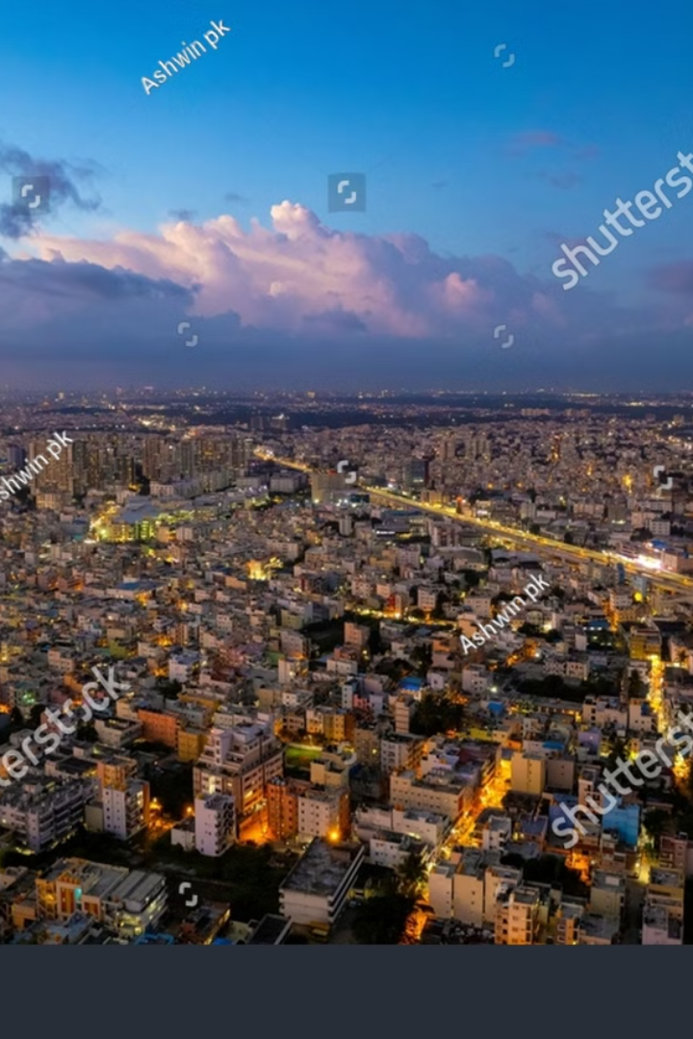
Zomato Bangalore Dataset Analysis – A Case Study
Uncover the culinary landscape of Bangalore through data analysis. We explore Zomato's presence, restaurant trends, and customer preferences to understand this bustling food scene.
Name : BHAVYA V
Department : MCA (BCU)
Semester : Third
USN : P18BR23S126018

Slide 2
AGENDA
1. INTRODUCTION
2. Overview of the Dataset
3. Data Cleaning and Preprocessing
4. Analyzing
5. Examining Pricing Trends Across Restaurants
6. Graphs and Charts
7. Implications and Recommendations
8. CONCLUSION

Slide 3
Introduction to Zomato's Presence in Bangalore
Zomato in Bangalore
Data Source
Bangalore, a city known for its tech hub and diverse population, boasts a flourishing food scene. Zomato, a leading online food delivery platform, plays a significant role in connecting food enthusiasts with restaurants across the city.
Our analysis leverages a comprehensive dataset of restaurants listed on Zomato in Bangalore. This dataset provides valuable insights into the types of cuisines, pricing, locations, and customer ratings.

Slide 4
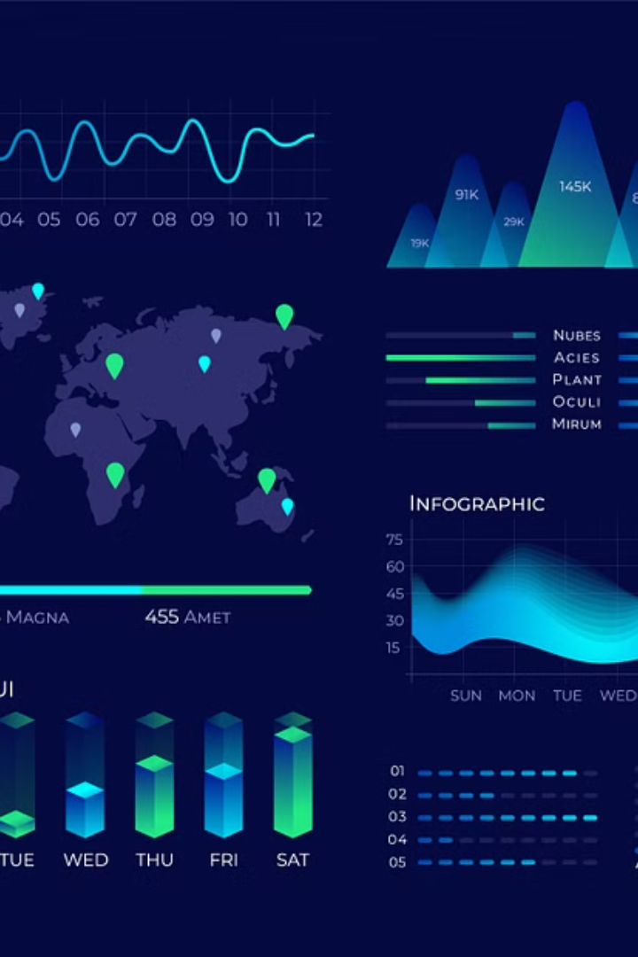
Overview of the Dataset
Restaurant Information
User Reviews
The dataset includes details about each restaurant, such as name, address, location, cuisine type, average cost, and ratings.
User reviews provide valuable feedback on the dining experience, including ratings, comments, and specific recommendations.
Operational Data
The dataset also contains operational information like restaurant hours, contact details, and online ordering availability.

Slide 5

Data Cleaning and Preprocessing
1
Handling Missing Values
Addressing missing data points through imputation or removal to ensure data integrity and accuracy.
2
Data Standardization
Standardizing data formats, units, and scales for consistent analysis and comparison.
3
Feature Engineering
Deriving new features from existing data, such as creating location clusters or analyzing sentiment from reviews.

Slide 6
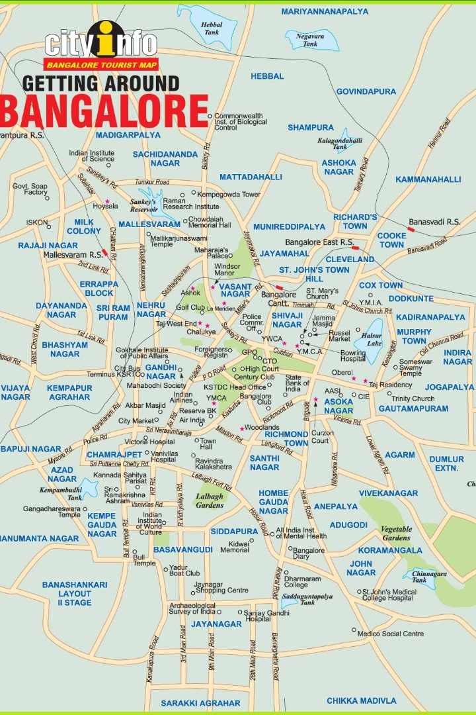


Analyzing Restaurant Distribution by Location
Location Clusters
Geographic Analysis
Identifying high-density areas for restaurants and analyzing trends in specific neighborhoods.
Exploring the distribution of restaurants across different zones and pinpointing areas with potential for expansion.

Slide 7




Exploring the Diversity of Cuisines
1
Top Cuisines
Popular Styles
2
Analyzing the most frequently offered cuisines and identifying popular variations.
Emerging Trends
3
Identifying cuisines experiencing growth and potentially becoming more popular.
International Influence
4
Exploring the presence of international cuisines and their adaptation to local palates.

Slide 8
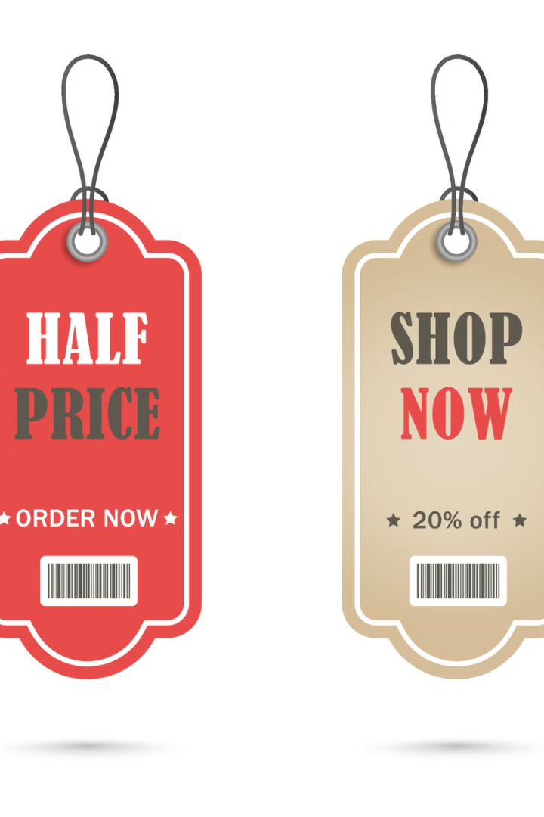
Examining Pricing Trends Across Restaurants
10
$50
Average Cost
Price Range
Analyzing the average cost of meals across different cuisines and location clusters.
Identifying the range of pricing options available to diners in Bangalore.
10%
Price Growth
Analyzing price changes over time and identifying factors influencing pricing adjustments.

Slide 9




Assessing the Impact of Customer Ratings
Rating Distribution
Correlation Analysis
Sentiment Analysis
Analyzing the distribution of customer ratings across different restaurants and cuisines.
Examining the relationship between customer ratings and other factors like cuisine, pricing, and location.
Analyzing user reviews to understand customer sentiment and preferences.

Slide 10
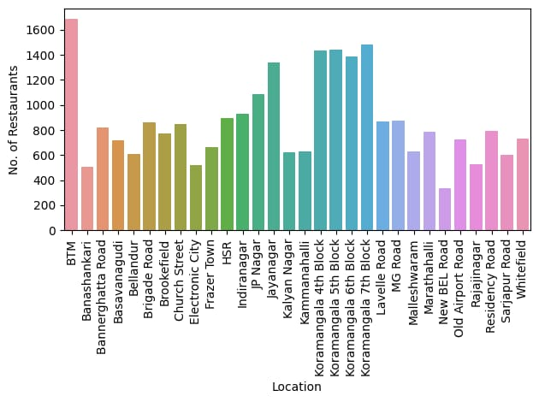
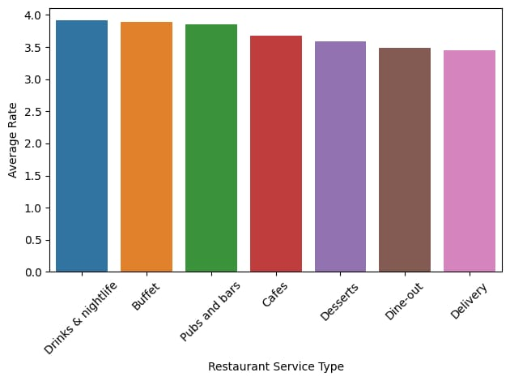
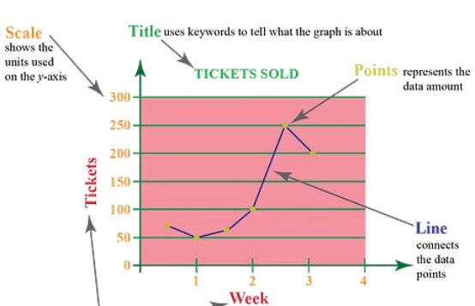
Visualizing Insights through Graphs and Charts

Slide 11
SHORT VIDEO
https://drive.google.com/drive/folders/1xm8ntJZLRtW03FHPWbNG0jRwdqjMrybZ

Slide 12
IMPLEMENTATION
https://github.com/Bhavya173025

Slide 13
Business Implications and Recommendations
Market Segmentation
1
Identifying specific target audiences based on cuisine preferences, pricing, and location.
Competitive Analysis
2
Analyzing competitors, their strengths and weaknesses, and identifying opportunities for differentiation.
Marketing Strategies
3
Developing effective marketing campaigns based on insights into customer preferences and trends.
Expansion Opportunities
4
Identifying new areas for restaurant expansion and growth based on data-driven insights.

Slide 14
CONCLUSION
The analysis of the Zomato Bangalore dataset provides valuable insights into the restaurant landscape of the city. Key findings indicate that restaurant distribution is concentrated in prime locations, with certain cuisines being more popular than others. Pricing plays a crucial role in customer ratings, with mid-range restaurants often receiving better reviews compared to extremely high-end or budget options.
From a business perspective, these insights can help restaurant owners optimize their pricing strategies, location choices, and menu offerings to attract more customers. Zomato can also use this data to enhance its recommendation algorithms and marketing efforts.
However, the study has limitations, such as missing data points and potential biases in customer reviews. Future research could involve real-time data analysis and integration of user behavior trends for deeper insights.
Overall, data-driven decision-making in the food industry can significantly improve customer experience, operational efficiency, and business growth

